Slide 1
Linux on Demand
Fog and Cloud Computing Project 20/21

Slide 2
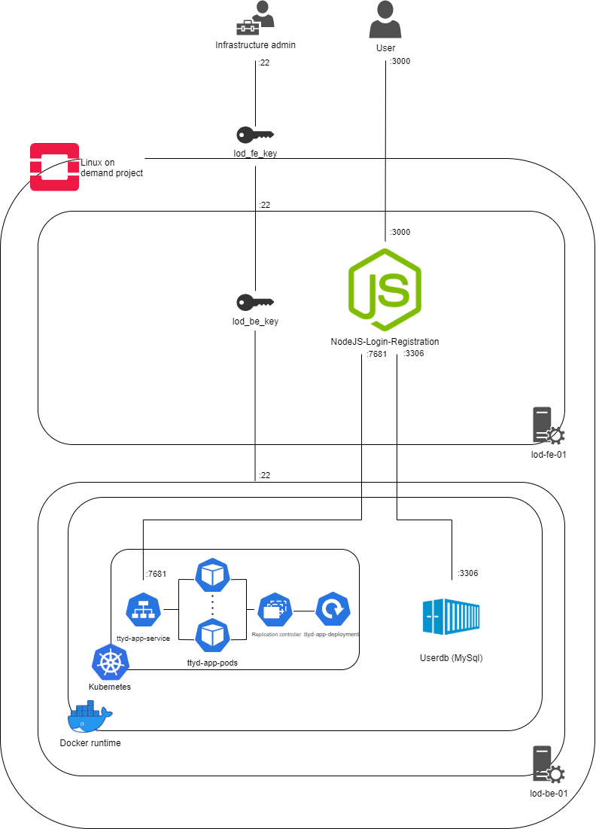
infrastructure as a Service (IaaS)
In this project, we have designed and configure an infrastructure that hosts a Linux virtual sandbox environment.
In order to configure the necessary infrastructure assets, we have used OpenStack as our IaaS platform.
In addition to this, we have adopted Docker and Kubernetes PaaS solutions to deploy the required containerized application and most importantly to automized all the platform we have used the terraform from Hashicorp.

Slide 3
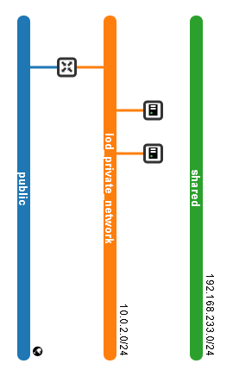
Platform as a service (PaaS)
Networking
Front end
Back end

